Slide 2
Update from the International Association of Insurance Supervisors
Conor Donaldson
07 August 2018

Slide 3
Overview
Insurance and Market Development
Overview of the IAIS and its Activities
Standard Setting
Implementation
Key initiatives 2018 - beyond

Slide 4
Insurance Markets and Economic Development
Clear relationship between insurance markets and economic growth – even stronger relationship in developing economies
Protects People and Business
Supports Economic Growth
Effective regulation and supervision matters if we want to realise the benefits of insurance
high level of asymmetry of information between providers and consumers
“business of promises” that requires confidence and trust in the industry if markets are to develop and grow.
Effective regulation and supervision build consumer confidence and trust
Notes:
Insurance is an essential financial tool that enables economic activity - making many economic activities possible in addition to its contributions to the economies in terms of protecting people and business and generating wealth in the broader economy.
Protecting People and Business
Protects people from falling (back) into poverty
Substitutes for government security programs
Minimises economic disruptions from disasters
Encourages loss mitigation
Generating Economic Growth
Supports risk management
Enables individuals / businesses to accumulate wealth and capital
Facilitates trade and commerce
Fosters more efficient capital allocation / mobilises savings
Insurance provides a safety net that allows people and businesses to absorb these risks.

Slide 5
Growing Insurance Markets
Global increases in insurance markets driven by Emerging and Developing Markets.
Insurance markets growth in these markets is often faster than GDP growth
GDP growth rates in last decade: EM ~4+%, Developed ~1+%
Almost 20% of global insurance premiums from EMs, and this proportion is increasing annually
Notes:
Emerging Markets are very relevant for the insurance sector.
Premium growth globally is increasingly driven by EM - global share of emerging market premiums grew by 1.2 ppt to 18.7%, in 2016.
Since 2006, insurance sector growth in the emerging markets has outpaced economic growth by a factor of more than 1.5.
Insurance companies are increasingly looking across borders for growth, and in particular towards emerging markets. This raises challenges for supervisors.
Paralleling this trend, insurance markets are increasingly developing across borders with international insurers gaining a larger share of global business. This increase is generated largely from business within EMs, reflecting their economic development and increased influence in the global economy. This growth is anticipated to continue.

Slide 6
Overview of the IAIS
Mission
Promote effective and globally consistent supervision of the insurance industry in order to develop and maintain fair, safe and stable insurance markets for the benefit and protection of policyholders
Contribute to global financial stability
IAIS membership is broad and diverse:
About 200 jurisdictions in nearly 140 countries
97% of the world's insurance premiums

Slide 7
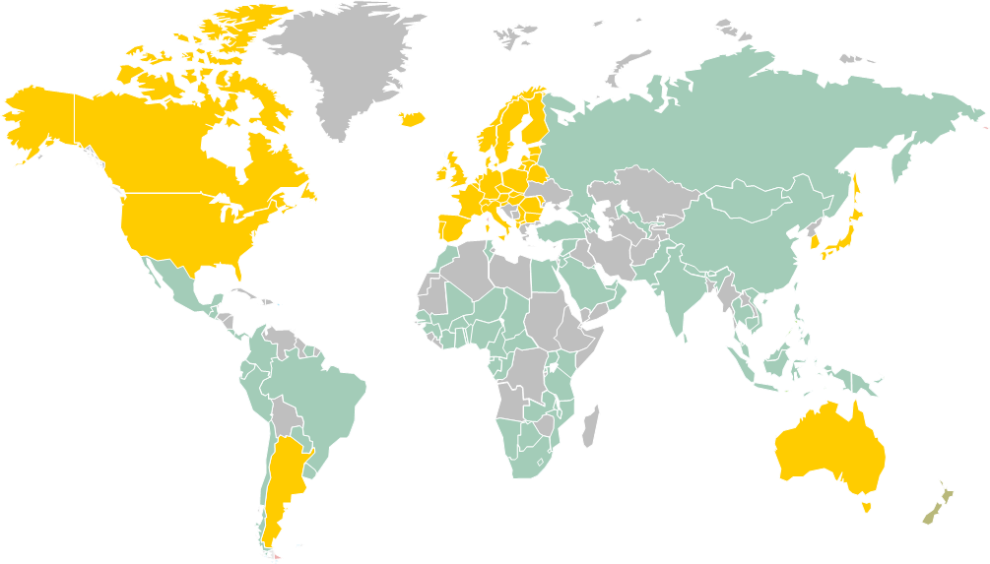
The IAIS and its role in supporting supervisors
More than half of IAIS Members come from Emerging Markets and Developing Economies
Our standard setting, financial stability and implementation activities take into account the market heterogeneity
Notes:
The IAIS Membership is large and diverse. The map shown on screen separates emerging / developing from developed markets. Applying the definition used by the International Monetary Funds’ World Economic Outlook, over 150 economies are classified as Emerging Markets and Developing Economies, which would include approximetly 2/3 of the IAIS Members
In short we are talking about a large / heterogeneous group of markets.

Slide 8
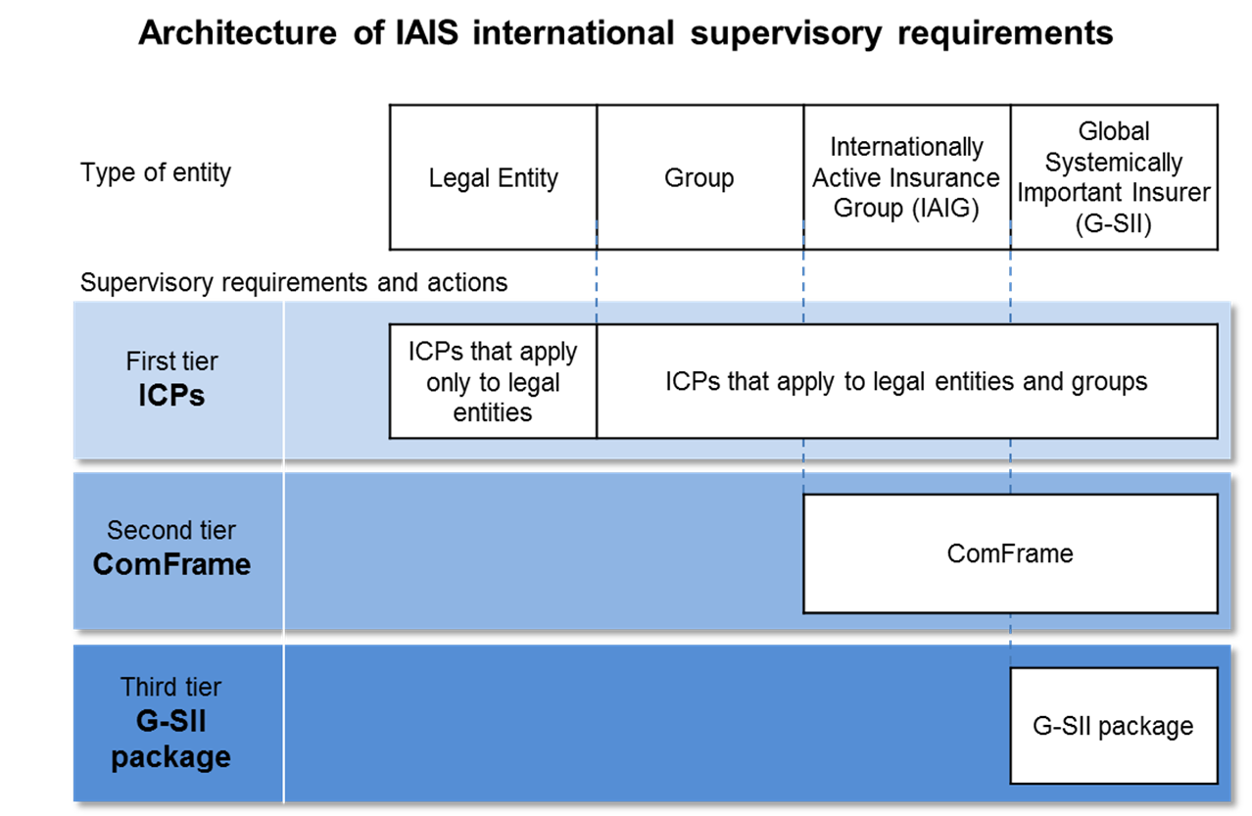
IAIS Standard Setting Activities
Notes:
On the standard setting side, the IAIS has been actively developing a robust system of standards to address the different types of firms
Critically important to note that principle of proportionality is embedded in our supervisory material.
“Proportionate” to the nature, scale and complexity of insurance business being conducted;
Developed in close consultation with industry with adaptations made as more knowledge & experience gained;
Forward-looking so as to allow for future innovations
The hierarch of our standards address proportionality, but we also embed the principle in our ICPs to address downward proportionality. In emerging / developing insurance markets this proportionate approach is key.

Slide 9
ICPs: Elements & Hierarchy
Insurance
Core
Principle
The “Principle Statement”: the essential elements that must be present in the supervisory regime
Should be adhered to by all insurance supervisors
Basis from which standards are developed
Standard
High-level requirements that are fundamental to the implementation of the ICP
Written as obligations of the supervisor
Linked to specific ICP
Guidance
Supports the core principle and standards and provides additional interpretation or detailed guidance on how to comply with or implement the standard
Does not set out new requirements
Often provides examples of possible ways of implementing the requirements in the standard/principle statement

Slide 10
Recent IAIS Supporting Material
Recently Adopted
FinTech Developments in the Insurance Industry
Application Paper on Product Oversight in Inclusive Insurance
Application Paper on Mutuals, Cooperatives and Community Based Organisations
Application Paper on Group Corporate Governance
Application Paper on Approaches to Supervising the Conduct of Intermediaries
Issues Paper on Index-Based Insurances
Issues Paper on Issues Paper on Climate Change Risks to the Insurance Sector
In Development
Application Paper on digital technology in inclusive insurance
Notes:
FinTech Developments in the Insurance Industry
This report contains a description of these innovations, their drivers and possible impacts based on a scenario analysis. The findings in this report are intended to inform the IAIS, the entire insurance supervisory community and other stakeholders allowing further strategic consideration and discussion of possible future work.
Application Paper on Product Oversight
This Application Paper provides guidance to supervisors, regulators and policymakers when considering, designing and implementing regulations and supervisory practices on product oversight in inclusive insurance markets. Whilst the primary focus of this Application Paper is inclusive insurance markets, some of the considerations and suggested approaches could be of interest to other insurance areas.
Application Paper on Mutuals, Cooperatives and Community Based Organisations This Paper describes Mutuals, Cooperatives and Community-based Organisations and their features to promote appropriate and proportionate supervisory measures and avoiding unnecessary regulatory barriers for MCCOs, focusing primarily on insurance supervisors seeking to enhance financial inclusion in developing markets
Application Paper on Group Corporate Governance
This Application Paper aims to provide good practices related to group governance
relevant to:
the supervision of the corporate governance framework, Board composition and the allocation of responsibilities between the Board at the head of the group and Boards at the level of the insurance legal entities (ICP 7);
the supervision of the risk management system and the reporting lines between control functions within the insurance group (ICP 8);
the allocation of responsibilities between the group-wide supervisor and other
involved supervisors (ICP 23); and
cooperation and coordination between involved supervisors with regard to groups
(ICP 25).
Application Paper on Approaches to Supervising the Conduct of Intermediaries
This Application Paper documents ideas on approaches that IAIS members may wish to consider when developing or revising a regime for the supervision of intermediaries, including when implementing ICP 18 (Intermediaries) and the relevant aspects of ICP 19 (Conduct of business), and incorporating them into their broader supervisory frameworks.
Issues Paper on Index Based Insurance
As index-based insurance is increasingly looked at as a means to manage weather and catastrophic events, support food security and enhance access to insurance, this Issues Paper provides background on this product, describes practices and actual examples and identifies related regulatory and supervisory issues and challenges
Application Paper on digital technology in inclusive insurance
To address issues for supervisors around innovations in this type of insurance of high relevance to financially excluded and underserved market segments.

Slide 11
Implementation Activities
Supporting implementation is a key strategic objective for the IAIS
Assessment against IAIS supervisory material
Supervisory practices exchange amongst supervisors on supervisory and emerging policy areas (eg, FinTech, Sustainability, Financial Inclusion)
Cooperation and Exchange amongst supervisors and other key stakeholders
The IAIS works closely with partners to achieve its implementation objectives
Financial Stability Institute (FSI)
A2ii
Sustainable Insurance Forum
International Development Finance Institutions (eg, World Bank, Asian Development Bank)
Capacity building entities, (eg, Toronto Centre)
Notes:
The IAIS as an association has always been committed to supporting implementation.
At the IAIS we have reaffirmed our commitment to supporting particular activities that bring benefit to our broad global membership – Assessment, dialogue and exchange on supervisory practices, and strengthening cooperation and exchange amongst supervisors.
We also work closely with our partners to bring capacity building to insurance supervisors. This work is primarily through partners and we have been very successful over the last few years in building meaningful and lasting partnerships in the area of capacity building. In 2018 we will continue to build partnered with other organisations to provide forums for supervisors to exchange ideas and develop good supervisory practices in areas such as financial inclusion (with the A2ii) and climate risk (Sustainable Insurance Forum, with the UN Environment Inquiry).

Slide 12
Themes Emerging from Input Stage
Insurance markets are evolving quickly
A number of emerging(ed) policy issues are impacting insurance and insurance supervision in a substantive way
Finalisation of agreed reforms is critically important
Supporting good supervisory practices
Engaging with emerging markets and developing economies (EMDEs)
Focusing on conduct and culture
Notes:
Insurance markets are evolving quickly
The main global players remain dominant and, while this is expected to continue in the coming years, new market disruptors are emerging.
Consolidation in mature markets will likely continue.
Technology is having a significant impact across the entire insurance business.
New lines of business have emerged (eg cyber insurance is a growing line of business for a number of insurers) but existing lines of business are under pressure.
Increasing convergence across sectors – for example through cross selling and product innovation – will continue, further raising the importance of cross-sectoral considerations in insurance supervision.
A number of emerging(ed) policy issues are impacting insurance and insurance supervision in a substantive way
The fiscal burden of aging populations in a number of developed markets will put additional pressure on the public sector, further necessitating a shift of the fiscal burden from the public to the private sector. As demand increases for retirement products, the need for sound and appropriate supervision in helping to close the protection gap will continue to grow in importance.
Understanding, assessing, and addressing the impact of climate risk is an area where insurance has a unique role to play. It presents underwriting and transition risks that need to be addressed, but also an opportunity for insurers to support climate risk signaling, mitigation and management. Insurers and insurance supervisors have been at the leading edge of sustainability and catastrophe discussions.
InsurTech is having a significant impact on insurers’ business models. Regulations and firm-level supervision will need to evolve to ensure policyholder protection is maintained without inadvertently stifling innovation.
Big data is driving improvements in underwriting but also creating new risks to how insurers operate. Technology changes such as cloud-based data storage raise new operational risks that supervisors will need to monitor and respond to.
Cyber security risks and cyber underwriting are important, distinct areas of focus from both a micro and macro perspective and should continue to be monitored to determine what actions may be needed and the opportunities offered by cyber insurance.
Financial inclusion remains an important global policy objective. There is a growing focus on the importance of insurance market development for broader, sustainable socioeconomic development.
Finalisation of agreed reforms is critically important
Further globalisation of insurance markets creates an increasing need for regulatory convergence and alignment.
The finalisation and implementation of the Common Framework for Internationally Active Insurance Groups (ComFrame), including the Insurance Capital Standard (ICS), should remain a priority.
Systemic risks to financial stability will require continued vigilance, underlining the important role of the IAIS in monitoring and assessing such risks and identifying appropriate supervisory responses.
Interconnectedness between sectors of the financial system will continue to increase. Avoiding regulatory arbitrage will require greater coordination and cooperation.
Supporting good supervisory practices
As the IAIS moves to finalise the substantial enhancements to its standards (ICP review and ComFrame), focus should shift to supporting good supervisory practices, including strengthened efforts to facilitate peer exchange and develop materials that support understanding of good supervisory practices.
The partnership model (eg with the Access to Insurance Initiative (A2ii) on financial inclusion and the Sustainable Insurance Forum (SIF) on climate risk) should be deepened.
Work with the Financial Stability Institute (FSI) could be further leveraged, for example by coordinating on FSI Insights on policy implementation.
Engaging with emerging markets and developing economies (EMDEs)
Market growth in EMDEs will continue to drive global premium growth.
EMDEs differ substantially in terms of economic size, level of development, legal and institutional frameworks, and other factors affecting financial systems. Insurance markets are growing at a faster rate in many emerging markets than those in developed markets, raising new challenges about building supervisory capacity to respond to a rapidly changing environment in these jurisdictions.
Emerging markets are increasingly incubators of new technologies and approaches as efforts are made to lower transaction costs and bring insurance to a wider range of traditionally underserved households and businesses.
Regulatory arbitrage will likely remain an issue.
Beyond implementation support, EMDE Members are looking for opportunities to engage in the IAIS’ broader activities, including standard-setting and insurance sector surveillance.
It will be important to balance multiple needs and priorities of EMDEs, and utilise regional and other multilateral approaches.
Focusing on conduct and culture
Culture and conduct are increasingly important for prudential supervisors, not just conduct supervisors.
Global standards, particularly around conduct of business, should be forward-looking to avoid becoming outdated as technology advances and new forms of intermediation emerge.
Culture issues can be as impactful as solvency issues in the eyes of the public.
Delivering our work more effectively
What should the IAIS stop doing?
Writing long papers
Sticking to old tools / old ways
Duplicative decision making
Making everything a priority / taking on too much
Duplicating what others are doing (eg, training)
Changing standards
What should the IAIS continue doing?
Being more agile
Inclusive and transparent
Strategy on corporate memory
Responsive to needs of Members
Understanding the impact of our supervisory material
Focus on supervisory application of our materials
More forward looking surveillance – how will development X affect supervision?
Act on important trends like innovation and sustainable growth
Strategic developments by other standard setting and regulatory bodies
Recognition of impact of technology / enhancing analytical skills
Finalisation of standards (eg, IASB, BCBS, IAA); Implementation of robust / appropriate frameworks by supervisors
Consumer protection / conduct important (enhancing focus on conduct by prudential regulators)
Enhanced focus on supervision / supervisory practices

Slide 13
Key Messages
More stability in the IAIS standards and a pivot to an increased focus on support for good supervisory practices and the implementation of agreed standards
The finalisation of the IAIS’ current commitments to the post-crisis reform agenda remains the priority, but increasingly also a focus on a range of emerging(ed) issues (eg FinTech, cyber, climate risk) that present opportunities, challenges and risks relevant to our Mission
Capacity building is key to helping ensure supervisory systems keep pace with rapid market growth in EMDEs
A holistic approach to prudential and market conduct supervision is called for – many risks to policyholder protection from the key trends and developments relate to the fair treatment of customers, but this in turn has financial soundness and stability implication
Proportionate supervision can help support insurance market development and the role of insurance in resilience and sustainable economic development
Delivery will require a change in how we work and communicate to be more agile and responsive

Slide 14
Next Five Year Strategic Plan and Financial Outlook

Slide 15
Looking forward – 2018 and beyond
Delivering on our commitments
Addressing systemic risk in the financial sector
Developing an Insurance Capital Standard that is implementable by end-2019
Addressing emerging risks
FinTech
Cyber
Sustainability / Climate Change
Supporting Implementation
Strengthening our assessment programme
Supporting peer-to-peer exchange on supervisory practices
Targeted capacity building work (eg, global partnership between the IAA, IAIS and A2ii)
Enhanced supervisory cooperation & information exchange
Developing our next Strategic Plan and Financial Outlook
Notes:
Delivering on our current commitments to help promote a more stable global financial system, covering our work on the mitigation of systemic risk in the insurance sector and the development of ComFrame, including an ICS that is implementable by the end of 2019 in the form of confidential reporting to supervisory colleges.
The IAIS must also be alert to emerging risks and opportunities. The IAIS must continue to be forward-looking and help shape supervisory responses to the emerging insurance landscape, including on issues such as FinTech, cybersecurity and sustainability.
Lastly, preparing to pivot towards assessing and supporting implementation of agreed global standards among our Members – the IAIS has adopted a strengthened assessment programme that will kick off in 2018 as a first step in this transition, with further efforts to support supervisory exchange, build targeted programmes to address demonstrated supervisory needs and continuing our efforts to strengthen supervisory cooperation and information exchange.
These themes will also feature in the development of our next strategic plan and financial outlook. Already this January our Executive Committee has held its first discussions on our next strategic plan and financial outlook. This work will conclude over the course of 2018, but as an association that gains strength from its inclusivity and breadth of membership, we will be looking for opportunities to engage all our Members in this process.

Slide 16
Contact information
Conor Donaldson
International Association of Insurance Supervisors
Centralbahnplatz 2 c/o BIS
tel: +41 61 280 8602
mobile: +41 76 350 8602
Skype: conordonaldson
e-mail: conor.donaldson@bis.org

